Slide 1
Farm Leasing Basics
ASAP Business of Farming Conference, February 22, 2014
Eric Mine – Land Loss Prevention Project

Slide 2
So You Want to Lease Land for Farming
What will the agreement look like?
What will I be leasing?
How and what will I pay?
Who is responsible for what? And what can I do?
What if I want to end the lease?
Could or should I use a business entity to lease the land?

Slide 3
What will the agreement look like?
Written vs. Oral
Required contents

Slide 4
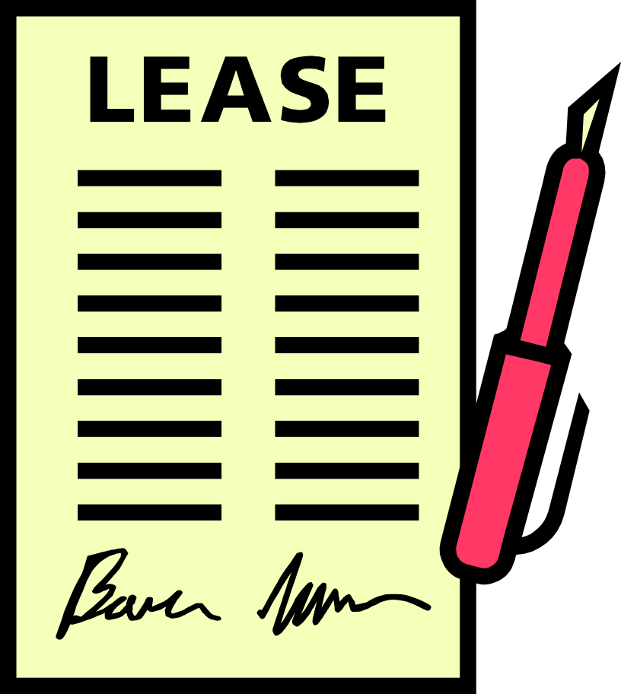
Lease Agreement
Should I have a written lease?
  Yes
Could I use an oral lease?
  Yes, in some cases. But don’t.
Should I record the lease?
  Yes (sometimes required)

Slide 5
Lease Agreement
What MUST be in the lease?
  Identity of landlord
  Identity of tenant
  Description of land to be leased
  Length of the lease
  Consideration to be paid
  Signatures of parties to be bound
What SHOULD be in the lease?
  Everything else you can possibly think of

Slide 6
Lease Agreements – Writing Required
NCGS § 22-2. Contract for sale of land; leases.
  … all other leases and contracts for leasing lands exceeding in duration three years from the making thereof, shall be void unless said contract, or some memorandum or note thereof, be put in writing and signed by the party to be charged therewith, or by some other person by him thereto lawfully authorized.

Slide 7
Lease Agreements – Writing Required
NCGS § 47-18. Conveyances, contracts to convey, options and leases of land.
  (a) No … (iv) lease of land for more than three years shall be valid to pass any property interest as against lien creditors or purchasers for a valuable consideration from the donor, bargainer or lesser but from the time of registration thereof in the county where the land lies, or if the land is located in more than one county, then in each county where any portion of the land lies to be effective as to the land in that county...

Slide 8
Lease Agreements – Minimum Contents
Purchase Nursery, Inc. v. Edgerton, 153 NC App 156 (2002)
  A valid lease contains four essential elements: (1) identity of landlord and tenant, (2) description of land to be leased, (3) a statement of the term of the lease, and (4) rental or other consideration to be paid.

Slide 9
What exactly am I leasing?
Property descriptions
Length of lease
Use and entry rights

Slide 10
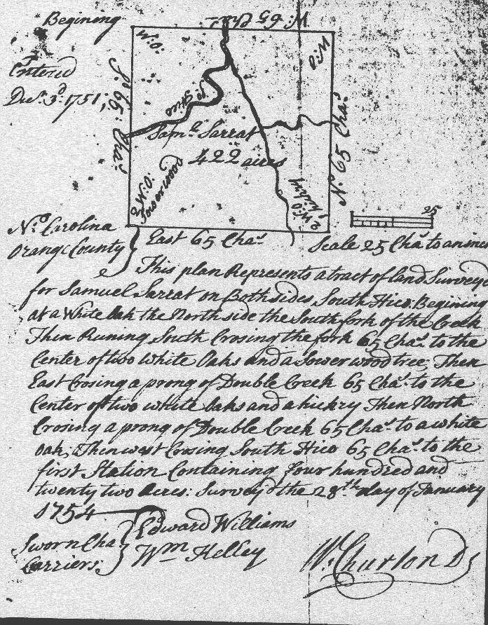
Property Description
Land
  Metes and Bounds
  Maps
Buildings
  Descriptions
  Use
Equipment
  Descriptions
  Use

Slide 11
Length of Lease
How long should the lease last?
  Short Term
  Long Term
Recording requirements
Lease renewal
Early cancellation clauses
Special terms in certain counties; NCGS §42-23

Slide 12
Use and Entry Rights
Rights of Way
  What’s on the other side of the property?
Right of Entry
  When can the landowner come onto the property?
Water Rights
  Wells, streams, ponds and other property
Hunting Rights
  Who can grant access?

Slide 13
How and What Will I Pay?
Cash vs. Crop Share
Timing of Payment

Slide 14
Types of Consideration
Cash Lease
Crop Share Lease
Pros
  Fixed cost
  Little landowner involvement
Cons
  You bear all risk
  Price re-negotiations
Pros
  Risk sharing
  Landowner cash inputs
  Landowner buy-in
Cons
  More complicated
  More trust required

Slide 15

Types of Consideration, continued
Flexible Lease
Hybrid
  Base Rent + Bonus = Total
    Base rent - $/acre
    Bonus - % of yield or revenue

Slide 16
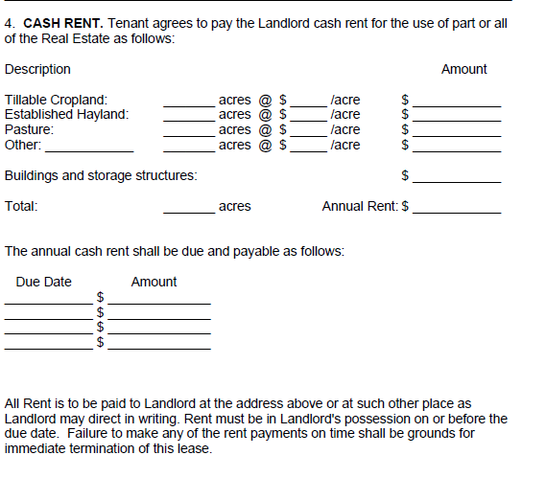
Types of Consideration – Cash Lease

Slide 17
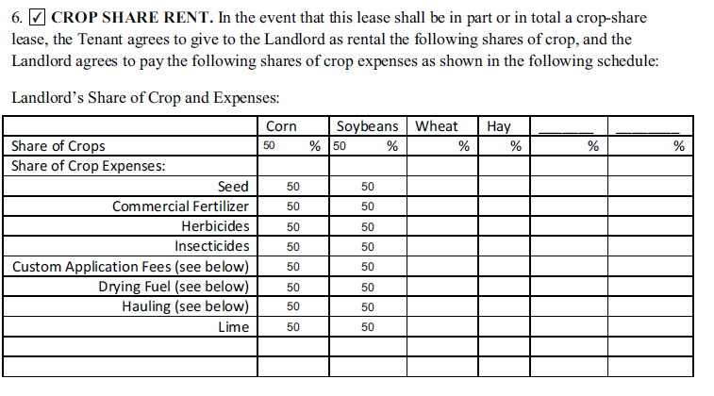
Types of Consideration – Crop Share Lease

Slide 18
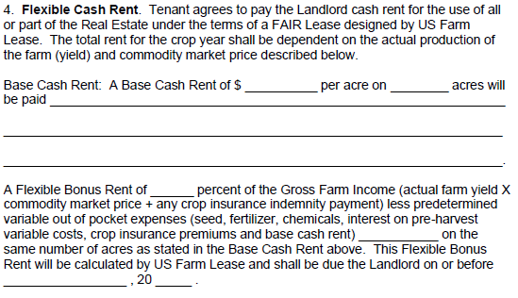
Types of Consideration – Flexible Lease

Slide 19
Timing of Payments
Cash Leases
  Typically paid on a certain date
Crop Share
  Dependent upon harvest date and marketing
Hybrid
  A mixture of the other two (as you might expect)

Slide 20
Who is responsible for what? And what can I do?
- Terms of the lease

Slide 21

Terms of Lease Will Depend on Negotiation

Slide 22
Rights and Responsibilities
Land Use
Maintenance
Labor
Insurance
Construction
Damage
Record Keeping

Slide 23
Rights and Responsibilities
Land Use Limitations
  Organic certifications
  Conservation practices
  Use of additives
  Crop limitations
  Subleasing and Assignment

Slide 24
Rights and Responsibilities
Maintenance
  What must be maintained?
  Who will do maintenance and repair?
  Who will pay for maintenance?
  Condition of property at expiration of lease
Labor
  Will one or both parties provide labor?

Slide 25
Rights and Responsibilities
Insurance
  Hazard and Casualty
    Property Insurance
    Comprehensive General Insurance
  Crop Insurance
  Worker’s Compensation Insurance
Limitations on Liability

Slide 26
Rights and Responsibilities
Construction and Improvements
  Removable Structures
  Permanent Structures
  Compensation for improvements
  Depreciation of structures

Slide 27
Rights and Responsibilities
Damage to leased property
  Who will repair?
  Who will pay?
  Maximum contribution from land owner

Slide 28
Rights and Responsibilities
Record Keeping
  Will you be required to keep records?
    Farming practices
    Additives
    Expenses
    Conservation plan
  When can land owner request/review those records?
  What are the consequences of bad record keeping?

Slide 29
Rights and Responsibilities
Other Considerations
  USDA farm payment agreements
  Environmental inspections prior to leasing
  FSMA
  Arbitration agreements

Slide 30
What if I Want to End the Lease or Something Goes Wrong?
Notice
Disputes

Slide 31
Terminating the Lease
Required Notice; NCGS §42-14
  Year-to-Year Leases
    Most common
    One month prior to end of lease term
  Month-to-Month Leases
    Less common
    One week prior to end of lease term
  Week-to-Week Leases
    Unlikely
    Two days prior to the end of lease term

Slide 32
Terminating the Lease
Disputes
  What if I stay after the lease is over?
  What if I can’t complete a harvest before the lease ends?
    Special provisions in certain counties; NCGS §42-23
  What if landowner sells?
  What if I can’t pay?
    Crop Liens
    Misdemeanors

Slide 33
Could or should I use a business entity to lease the land?

Slide 34
Business Entities
What sort of entities are possible?
  Sole Proprietor
  General Partnership
  Limited Partnership
  Corporation
  Limited Liability Company
So what’s the difference?
  Taxes and Liability

Slide 35
Business Entities
Advantages of LLC formation
  Management plan
  Succession planning
  Limitation of liability
    Must meet certain requirements
  Taxation
Disadvantages of LLC formation
  Management plan
  Yearly filings

Slide 36
Questions?
Contact Info:
Eric Mine, Staff Attorney
Land Loss Prevention Project
1-800-672-5839
www.landloss.org

